Slide 1


SIMATS ENGINEERING Saveetha Institute of Medical and Technical Sciences Chennai-602105
Comprehensive Airline Reservation System Using Structures, Pointers, and File Handling in C
CSA0203 – C Programming
Guided by:
Dr. S.K. Saravanan
Presented by
Teja Abhishek Reddy A (192312497)
Hemanth Reddy M (192312534)
Poorna Chandu K (192312585)

Slide 2
INTRODUCTION
Airline reservation systems are used to manage flight bookings efficiently.
Manual ticket booking is time-consuming and prone to errors.
A computerized reservation system stores passenger, flight, and booking information securely.
This project uses Structures, Pointers, and File Handling in C for efficient data management.
The system provides quick booking, cancellation, and record retrieval.

Slide 3
PROBLEM STATEMENT
Manual reservation systems require more time and effort.
Maintaining passenger and flight records manually leads to errors.
Searching available flights is difficult.
Updating bookings and cancellations manually is inefficient.
Secure storage of reservation records is challenging.

Slide 4
ABSTRACT
The Comprehensive Airline Reservation System is developed using the C programming language.
It automates airline ticket booking, cancellation, passenger management, and flight information management.
Structures are used to organize passenger and flight records, pointers enable efficient memory access, and file handling provides permanent data storage.
The system reduces manual work, improves booking accuracy, and allows fast retrieval of reservation details.

Slide 5
EXISTING METHOD
Flight reservations are maintained manually or using basic spreadsheets.
Passenger information is stored on paper records.
Booking and cancellation require manual updates.
Flight availability is checked manually.
High possibility of duplicate bookings and data loss.

Slide 6
PROPOSED SYSTEM AUTOMATED AIRLINE RESERVATION SYSTEM
Digital storage of passenger and flight information.
Ticket booking and cancellation using C programming.
Permanent storage using file handling.
Efficient memory management using pointers.
Structured data organization using structures.
Fast search, update, and report generation.

Slide 7
Module 1: Flight Scheduling
Key Functionalities & Implementation:
Create and maintain flight records using structures in C.
Use structure variables to organize related flight data.
Use pointers to structures to efficiently access, update, and manage flight schedules.
Add new flight details to the system.
Display all available flights.
Search for a specific flight using its flight number.
Data Managed:
Flight Number: Unique flight identifier (e.g., AI-101)
Source: Departure airport/city
Destination: Arrival airport/city
Date: Date of departure (DD/MM/YYYY)
Departure Time: Scheduled departure time (HH:MM)
Total Seats: Maximum passenger capacity
Available Seats: Remaining seats available for booking
Ticket Fare: Base cost per seat

Slide 8


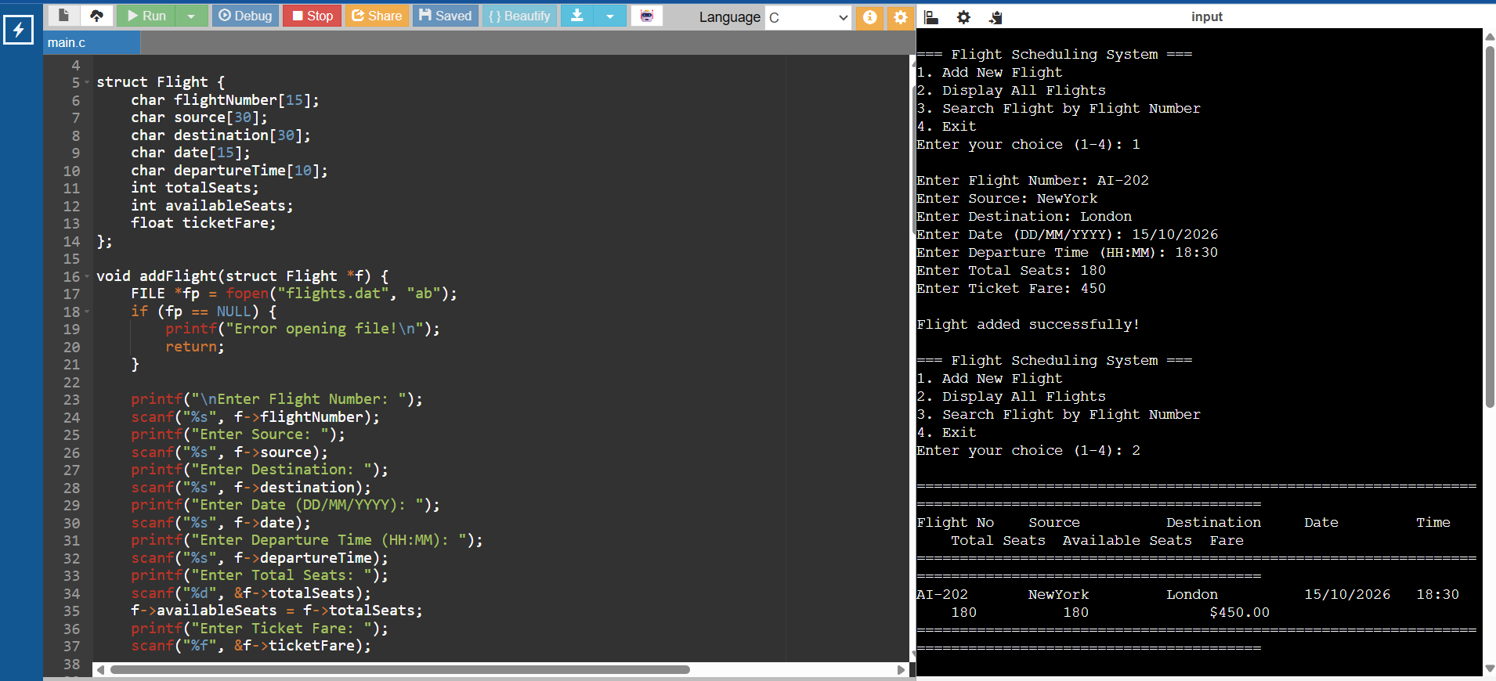
Module 1: Working model

Slide 9
Module 2: Booking System & Ticket Generation
Key Functionalities & Implementation:
Validate passenger seat availability before confirming reservations.
Use structures to represent passenger profiles and generated tickets.
Use pointers to structures to dynamically assign seats and update flight availability in real time.
Generate a unique PNR (Passenger Name Record) or Booking Reference ID for each transaction.
Calculate total ticket cost based on base fare, seat class, or applicable taxes.
Format and generate printable digital flight tickets with complete travel details.
Data Managed:
Booking Reference / PNR: Unique identifier for the reservation
Passenger Name: Full name of the traveler
Passenger Age & Gender: Basic demographic details
Flight Number: Associated scheduled flight
Seat Number: Assigned seat location
Class Type: Economy, Premium Economy, or Business class
Total Fare Paid: Final calculated price including charges
Booking Status: Confirmed, Waiting, or Cancelled.

Slide 10
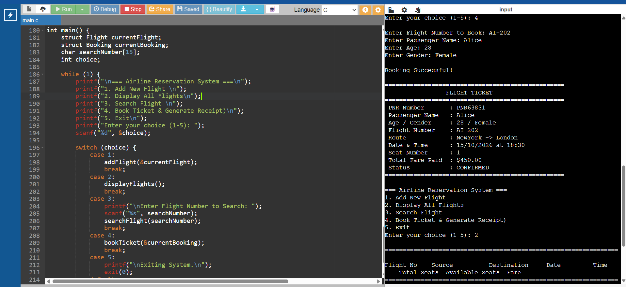
Module 2: Working model

Slide 11
Module 3: Passenger Records
Key Functionalities & Implementation:
Store and organize passenger histories using structures in C.
Use pointers to structures to query, update, and modify passenger information efficiently.
Implement file handling (fopen, fwrite, fread, fseek) to ensure permanent storage and retrieval of passenger databases across sessions.
Search for passenger details using unique identifiers like PNR, Passport/ID number, or Full Name.
Display a complete manifest (passenger list) for any specific flight number.
Handle ticket cancellations by modifying passenger records and automatically incrementing available seat counts in the flight scheduler.
Data Managed:
PNR / Booking ID: Unique transaction reference
Passenger Name: Full name of the passenger
Age & Gender: Demographic profile
Contact Number & Email: Communication details
Passport / ID Number: Government-issued identification
Assigned Flight Number: Associated flight identifier
Assigned Seat Number: Allocated seat code
Booking Status: Active, Checked-in, or Cancelled

Slide 12
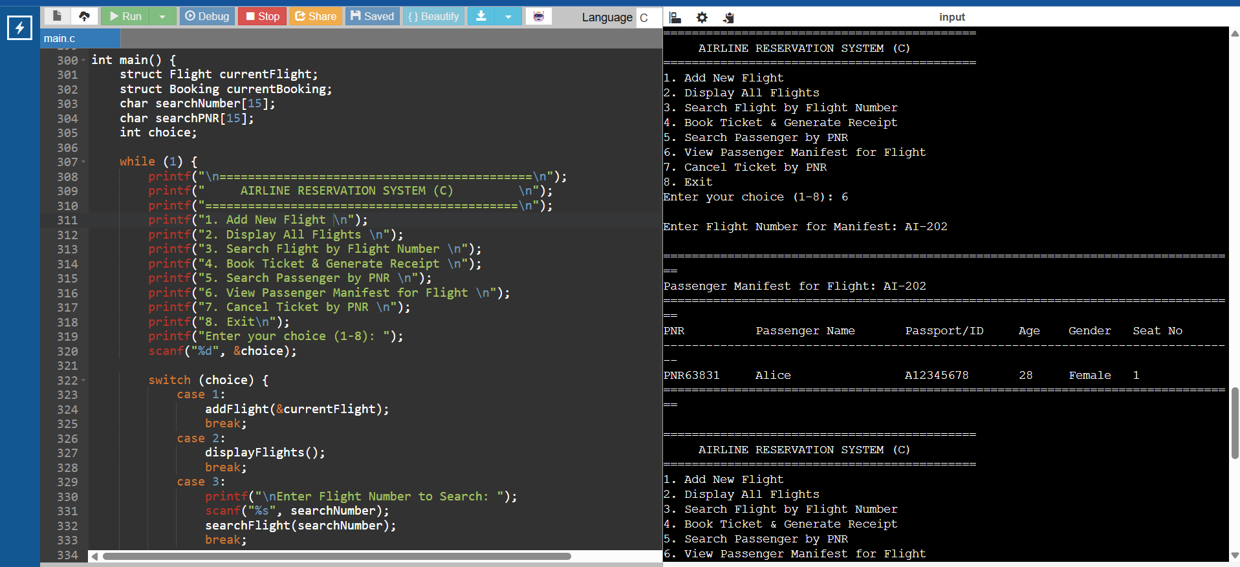
Module 3: Working model

Slide 13
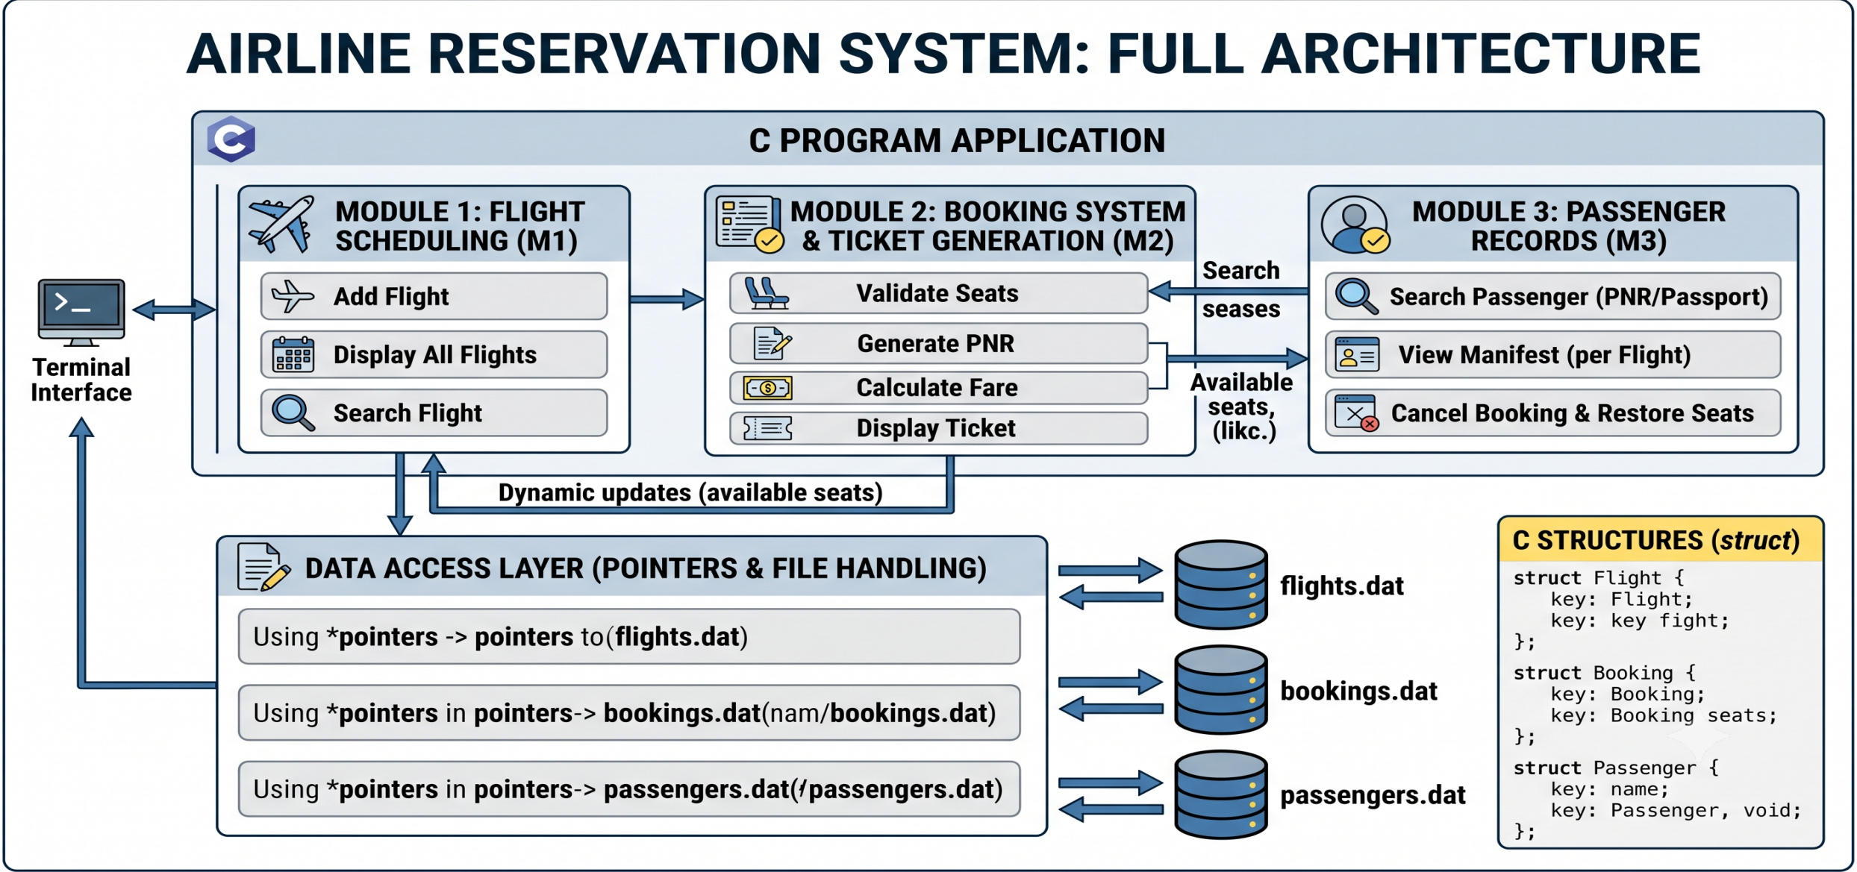
System Architecture

Slide 14
CONCLUSION
The Comprehensive Airline Reservation System simplifies airline booking operations by automating passenger registration, flight management, ticket booking, and cancellation.
Using structures, pointers, and file handling ensures efficient data organization, memory management, and permanent storage.
The system minimizes manual errors, improves accuracy, and provides a fast and reliable reservation process.

Slide 15
REFERENCES
Herbert Schildt, C: The Complete Reference, McGraw-Hill Education.
Yasha Vant Kanetkar, Let Us C, BPB Publications.
Brian W. Kernighan & Dennis M. Ritchie, The C Programming Language, Prentice Hall.
Roger S. Pressman, Software Engineering: A Practitioner's Approach.
Airline reservation system case studies and C programming documentation. Research papers on Airline Reservation Management Systems.
ISO/IEC documentation related to software development and data management.

Slide 16
THANK YOU!

